Slide 1
Zuul API Gateway

Slide 2
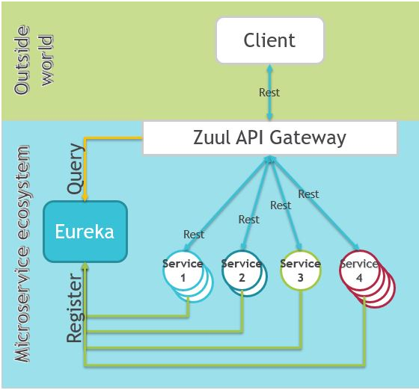
Role of Zuul API Gateway in MicroServices
Our or Third Party Clients
Internal to Micro Services Architecture

Slide 3
What is Zuul API Gateway?
Zuul is a JVM based router and server side load balancer by Netflix. It provides a single entry to our system, which allows a browser, mobile app, or other user interface to consume services from multiple hosts without managing cross-origin resource sharing (CORS) and authentication for each one.
We can integrate Zuul with other Netflix projects like Hystrix for fault tolerance and Eureka for service discovery, or use it to manage routing rules, filters, and load balancing across your system.
An API Gateway, aka Edge Service, provides a unified interface for a set of microservices so that clients no need to know about all the details of microservices internals. However, there are some pros and cons of using the API Gateway pattern in microservices architecture.

Slide 4
Why Zuul API Gateway?
Advantages:
Provides an easier interface to clients, by providing abstraction to external world.
Can be used to prevent exposing the internal microservices structure to clients.
Allows refactoring of microservices without forcing the clients to refactor the consuming logic.
Can centralize activities like security, monitoring, rate limiting, etc.
Disadvantages:
It could become a single point of failure if the proper measures are not taken to make it highly available.
Knowledge of various microservice APIs may creep into the API Gateway.

Slide 5
How to use Zuul API Gateway?
Create a SpringBoot project with Web, Config Client, Eureka Discovery, Zuulstarters and annotate the main entry-point class with @EnableZuulProxy.
import org.springframework.boot.SpringApplication;
import org.springframework.boot.autoconfigure.SpringBootApplication;
import org.springframework.cloud.netflix.zuul.EnableZuulProxy;
@EnableZuulProxy
@EnableDiscoveryClient
@SpringBootApplication
public class ShoppingcartUiApplication {
public static void main(String[] args) {
SpringApplication.run(ShoppingcartUiApplication.class, args);
}
}

Slide 6
Content of POM file
<dependency>
<groupId>org.springframework.boot</groupId>
<artifactId>spring-boot-starter-web</artifactId>
</dependency>
<dependency>
<groupId>org.springframework.cloud</groupId>
<artifactId>spring-cloud-starter-config</artifactId>
</dependency>
<dependency>
<groupId>org.springframework.cloud</groupId>
<artifactId>spring-cloud-starter-netflix-eureka-client</artifactId>
</dependency>
<dependency>
<groupId>org.springframework.cloud</groupId>
<artifactId>spring-cloud-starter-netflix-zuul</artifactId>
</dependency>
Eureka Client, helps in Service Discovery
Netflix Zuul

Slide 7
Bootstrap.properties (TBD)
bootstrap.properties
zuul.routes.producer.url=http://localhost:8080
spring.application.name=shoppingcart-ui
server.port=8080
eureka.client.service-url.defaultZone=http://localhost:8761/eureka/
Can be accessed externally with below URL
http://localhost:8080/producer/employee
Note: In Zuul Gateway Application, below property can be used(instead of zuul.routes.producer.url)
zuul.routes.producer.serviceId=employee-producer

Slide 8
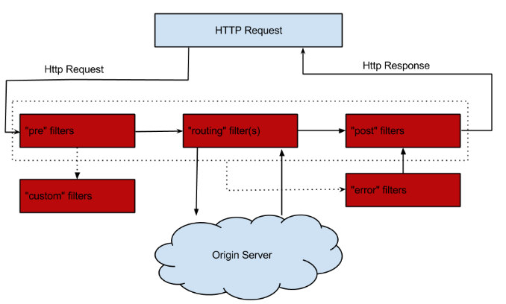
What are Zuul Filters?
A number of different types of Filters can be used with Zuul API Gateway. A Filter can be used to perform custom action/steps, before/after processing Request

Slide 9
Zuul Filters
Next we define the 4 types of filters supported by Zuul-
PRE Filters execute before routing to the origin. Examples include request authentication, choosing origin servers, and logging debug info.
ROUTING Filters handle routing the request to an origin. This is where the origin HTTP request is built and sent using Apache HttpClient or Netflix Ribbon.
POST Filters execute after the request has been routed to the origin. Examples include adding standard HTTP headers to the response, gathering statistics and metrics, and streaming the response from the origin to the client.
ERROR Filters execute when an error occurs during one of the other phases.
Try to customize Fileters, like adding/removing header, not forwarding request to a certain micro service, or displaying count how many times a specific url has been called, etc…etc…
Below URL has info on how to customize an Header
https://sivalabs.in/2018/03/microservices-part-5-spring-cloud-zuul-proxy-as-api-gateway/
https://cloud.spring.io/spring-cloud-netflix/multi/multi__router_and_filter_zuul.html

Slide 10
Path Customization
Now, from the UI, we can make a request to fetch products at http://localhost:8080/api/catalog-service/products. By default, Zuul will strip the prefix and forward the request.
You can also customize the path mappings of a service as follows:
zuul.routes.catalogservice.path=/catalog/**
zuul.routes.catalogservice.serviceId=catalog-service
With this configuration, you can use URL http://localhost:8080/api/catalog/products which will be forwarded to the service with serviceId catalog-service.
By default, all the services registered with Eureka Server will be exposed. You can use zuul.ignored-services property to disable this behavior and expose only the explicitly configured services.
zuul.ignored-services=*
zuul.routes.catalogservice.path=/catalog/**
zuul.routes.catalogservice.serviceId=catalog-service
zuul.routes.orderservice.path=/orders/**
zuul.routes.orderservice.serviceId=order-service
With this configuration, only catalog-service, order-service are exposed through Zuul proxy but not inventory-service.

Slide 11
Zuul with Multi Microservices
By default, all the services registered with Eureka Server will be exposed. You can use zuul.ignored-services property to disable this behavior and expose only the explicitly configured services.
server.port=5321
zuul.ignored-services=*
zuul.routes.catalogservice.path=/catalog/**
zuul.routes.catalogservice.serviceId=catalog-service
zuul.routes.orderservice.path=/orders/**
zuul.routes.orderservice.serviceId=order-service
With this configuration, only catalog-service, order-service are exposed through Zuul proxy but not inventory-service.
Note: How to access a service
http://localhost:5321/catalog
Zuul Timeout Exception is best explained in below URL
https://stackoverflow.com/questions/28904247/zuul-timing-out-in-long-ish-requests

Slide 12
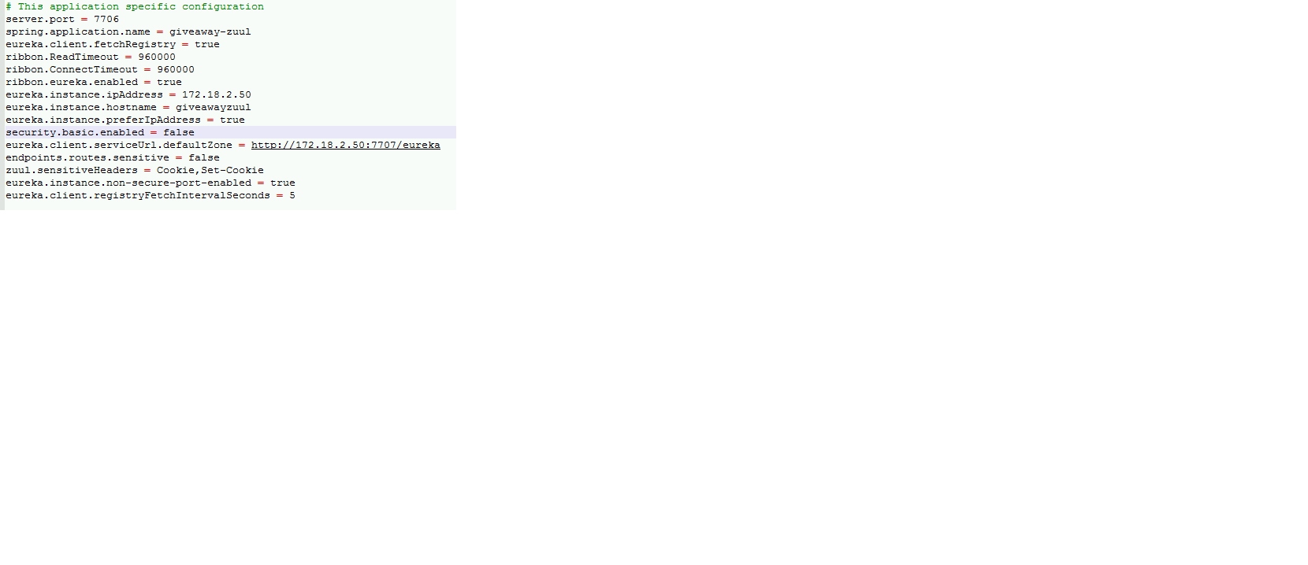
Zuul timeout Settings

Slide 13
Zuul Configurations to ByePass Headers
zuul:
sensitiveHeaders: Cookie,Set-Cookie
OR
zuul.sensitiveHeaders=Cookie,Set-Cookie
Pls refer below URLs
https://github.com/spring-cloud/spring-cloud-netflix/issues/3126
https://github.com/Netflix/zuul/issues/218

